Slide 1
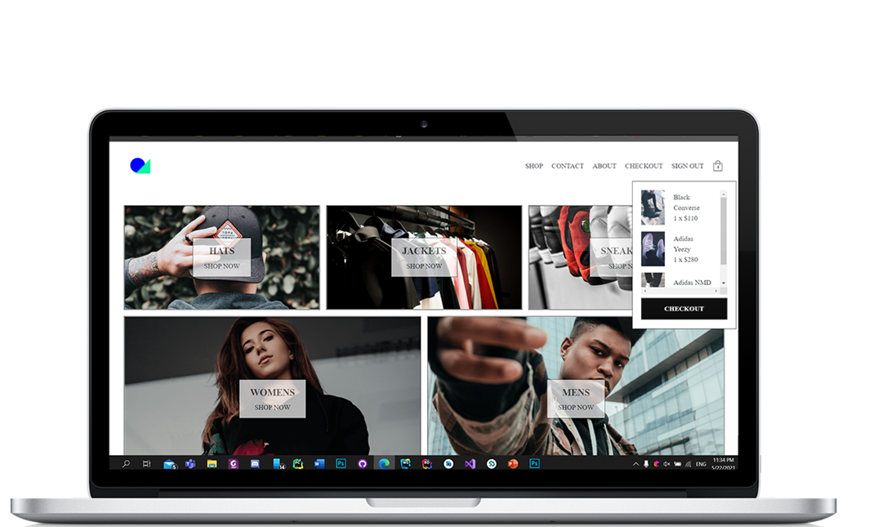

React Store App/Management
by
Seaside Development

Slide 2
AGENDA
Introduction
The Problem
Solution
App Portfolio
Features
PWA Complainant
What is Next
Question

Slide 3

PROBLEM
SO, WHAT ARE WE TACKLING?
In Barbados we find that there is a lack of well-structured an optimized application and we want to get rid of that by making clean elegant multi-platform application
Many clients are fearful of complex implementations in which they cannot comprehend or follow themselves.
Small business face the most hurdles in providing services to end users
Shy away from perils of setting up backend.
Many small businesses often lack individualistic backend and services

Slide 4

SOLUTION
What we are offering are single code-based application and resolving many issues due to high development cost
Content Management
Integrated payment systems
Looks and feels as fluid as a mobile version
Push notifications
Comprehensive Backend Features and services

Slide 5
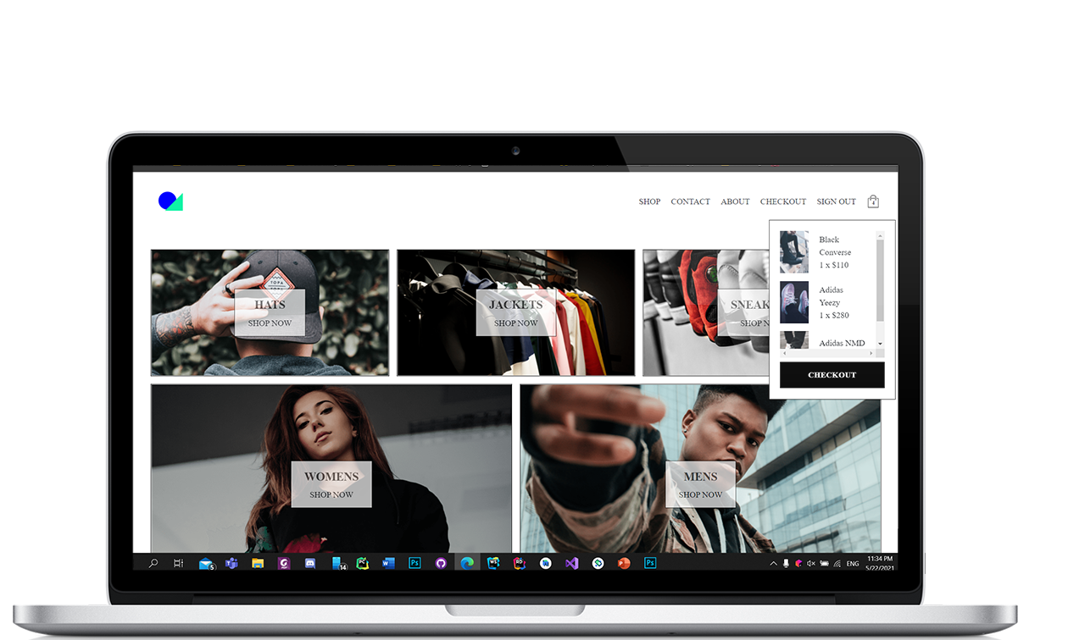
APP PORTFOLIO
The site is available on Web & Mobile
An Ecommerce App
o Secure
o Robust
o Backend Services
o Push Notifications

Slide 6
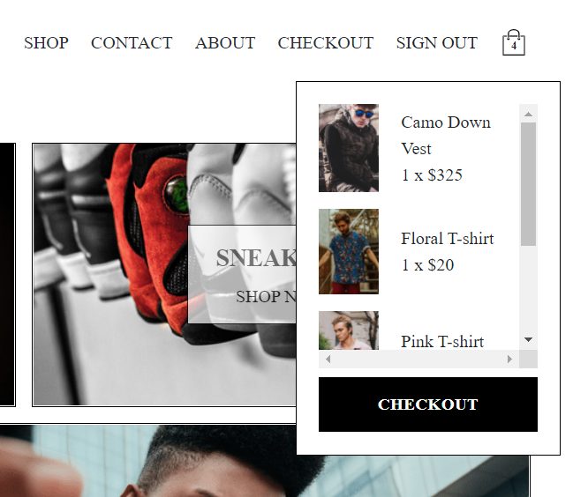
APP PORTFOLIO CONT’D
An Easy-to-use interface
Quick Access other pages
Mobile Friendly
Page caching
Real time updates

Slide 7







FEATURES/TOOLS
We want our client's app to work for them and for their end users
Push Notifications
Node Server
Heroku Deployment
Email JS
Stripe API
Firebase
Google Analytics

Slide 8
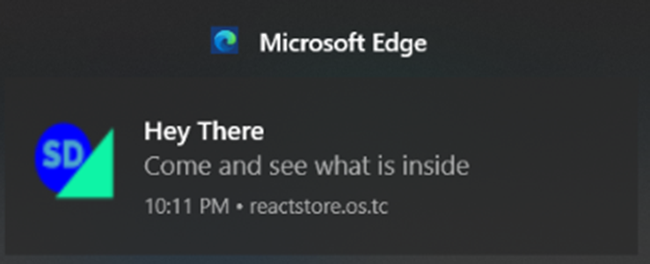
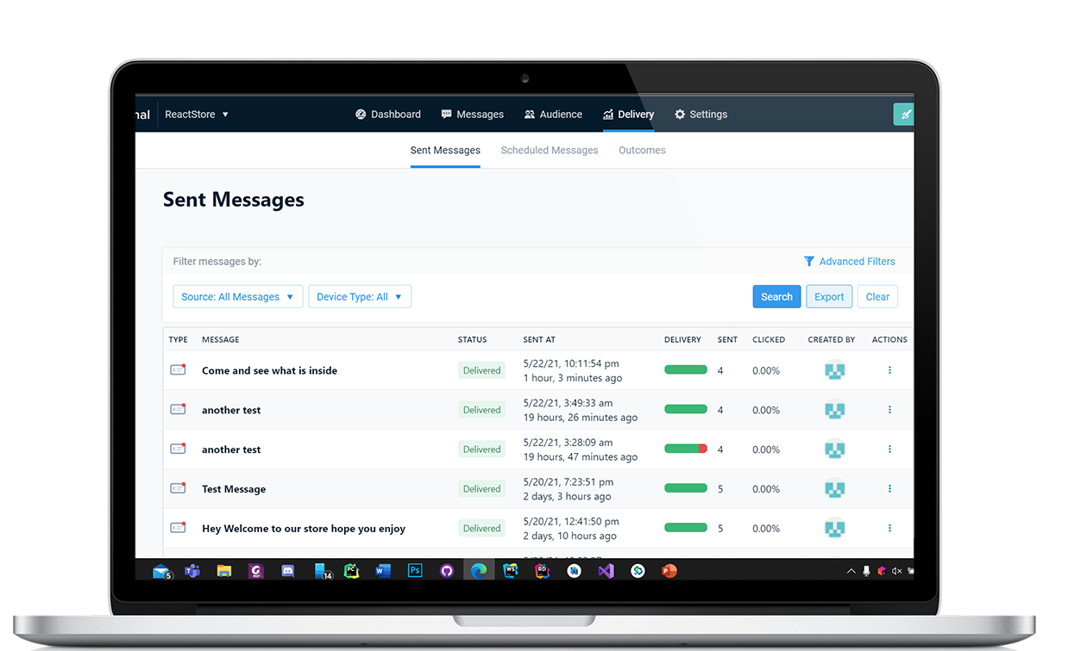
CONT’D
PUSH NOTIFCATIONS- 01
One Signal and Firebase Cloud Messaging
We leverage the use of One Signal to enable the client to send notifications to the end users
It allows for In App notifications. Great for greeting newcomers to the app
Traditional push notifications are great for reminding customers of any thing relevant about the app for the user account. i.e., empty cart or inactivity
Increasing app engagement

Slide 9
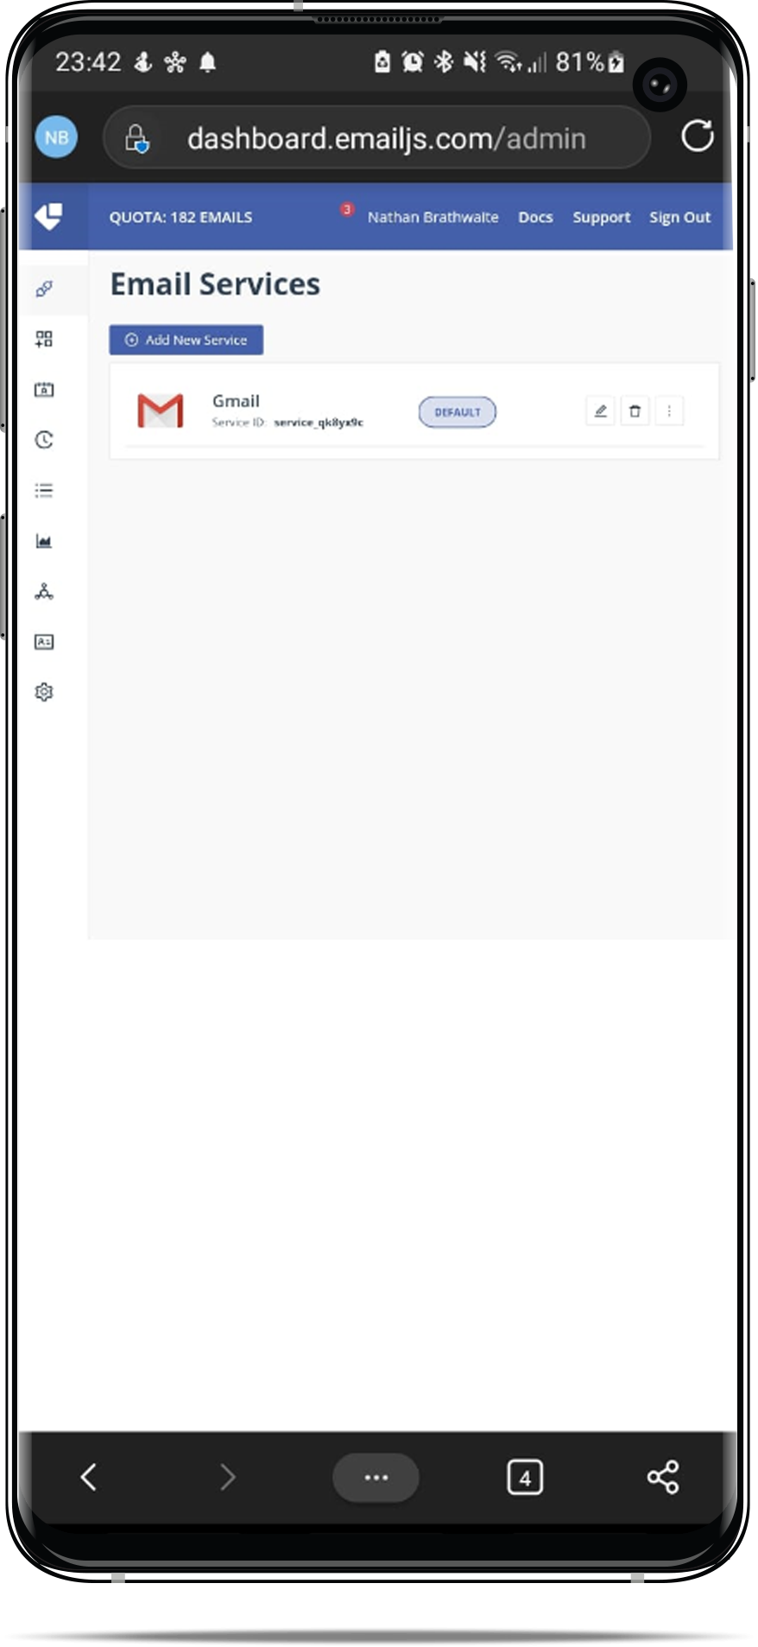
CONT’D
EMAIL HANDINGLING - 03
Taking Advantage Of The JavaScript Language We Used EMAIL JS To Handle The Emailing
Allow the client to send emails to subscribed end users
Sort emails by tags and so much more
Quickly send emails from client to end users from anywhere

Slide 10
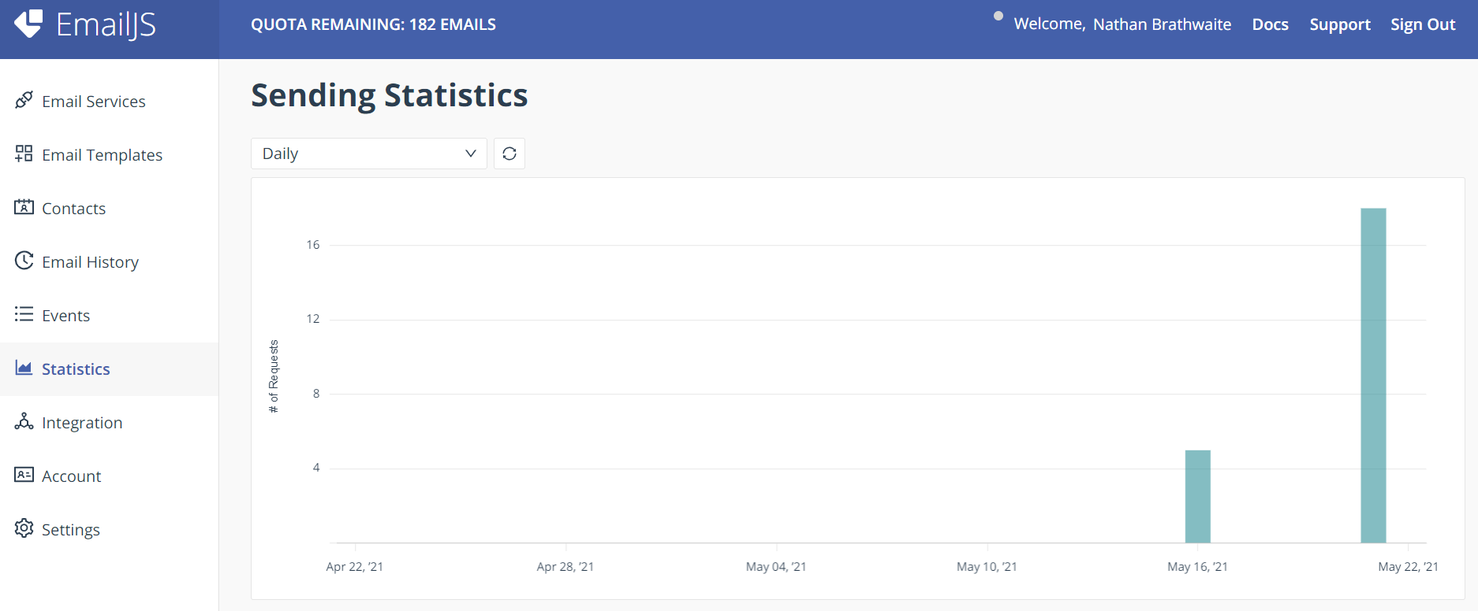
EMAIL JS ON THE WEB

Slide 11
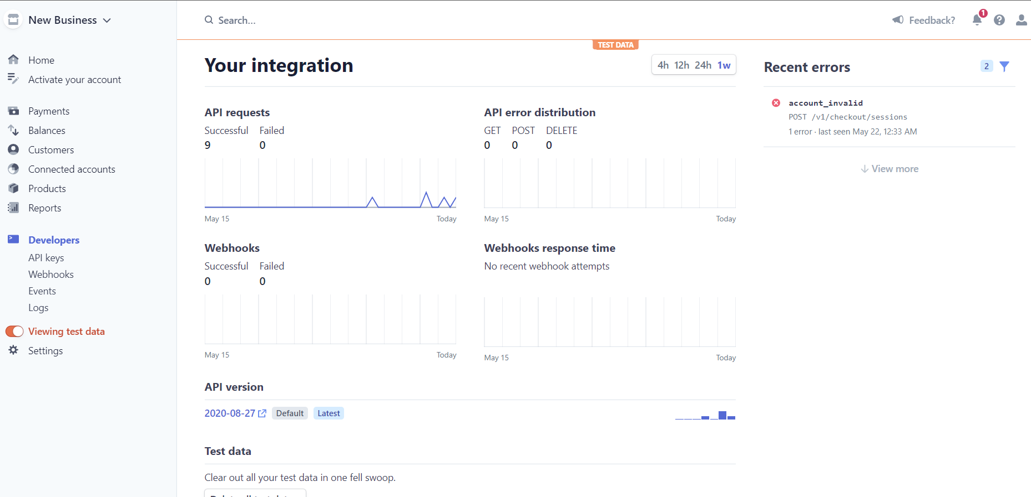
CONT’D
PAYMENT HANDINGLING - 04
By using the Stripe API, we can seamlessly integrate payments
Track payments made in the app
Can refund end users
Track successful and failed payments

Slide 12
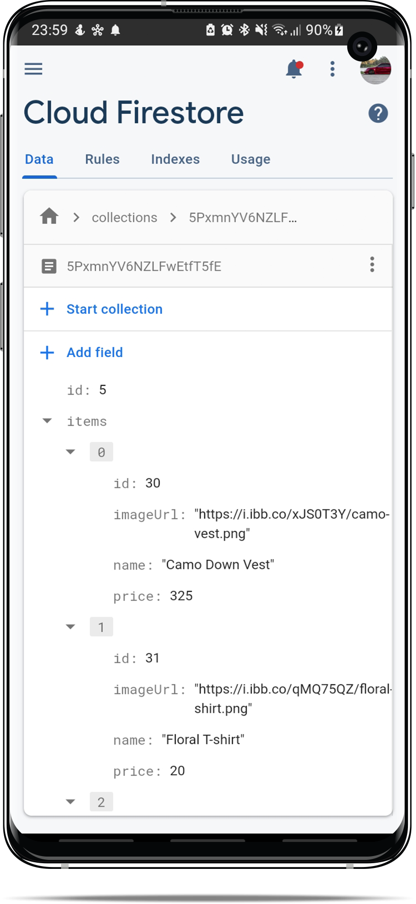
CONT’D
USING FIREBASE/ JETADMIN
We use the cloud service Firebase for data storage and user Authentication
Allowing to manage user. Revoke, add etc.
Can Easily adjust the database rules and create cloud functions
Easily modify the data for the store front. Stored in JSON
Firebase has strong security protecting the client and end users

Slide 13
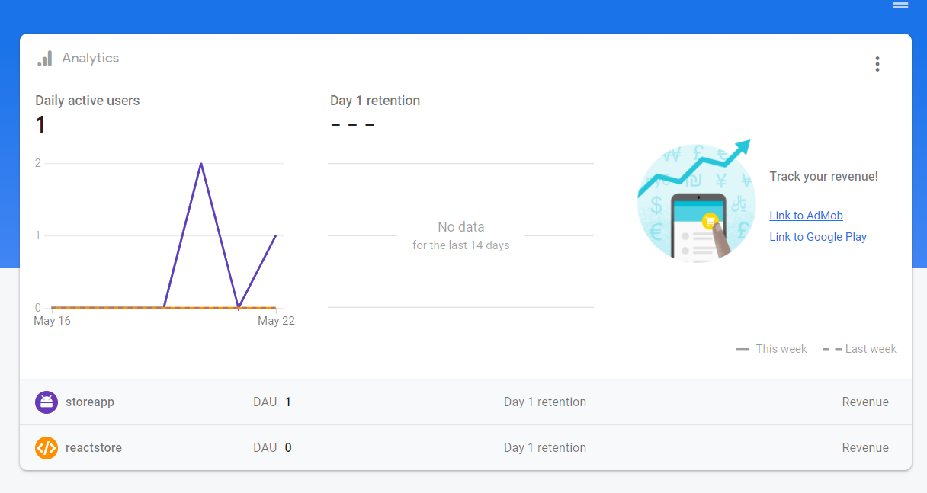
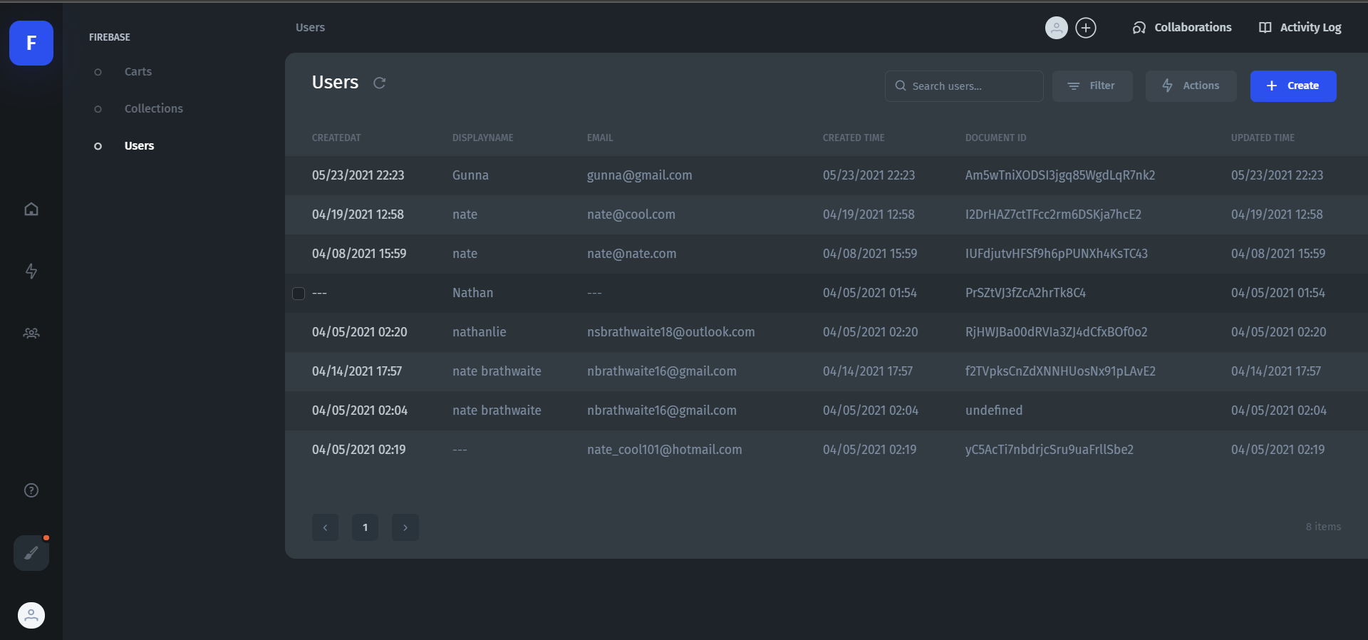
Cont’d
AS easy as 1, 2, 3
By adding a few lines of code, we can track simple user data to help analyze the Web App.
Seamlessly integrate an Admin Dashboard with open source Jetadmin. So, clients don’t have to interface with the database. Keep database integrity while allowing for content management

Slide 14
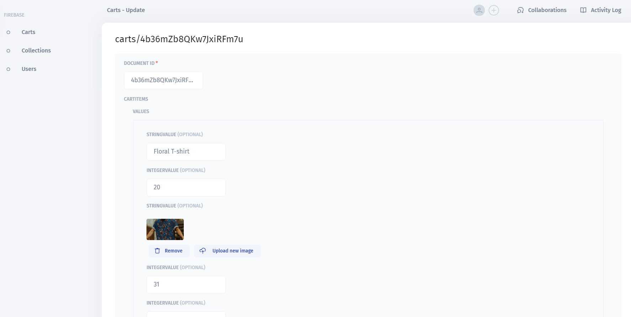
Admin Dashboard

Slide 15
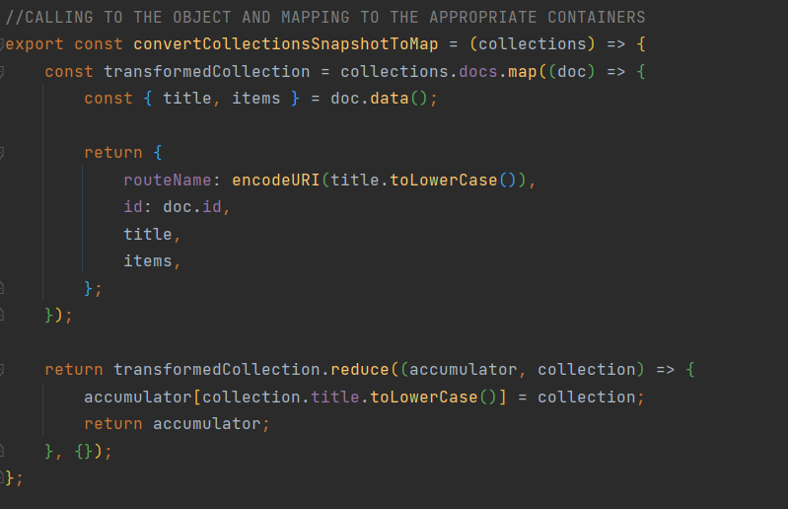
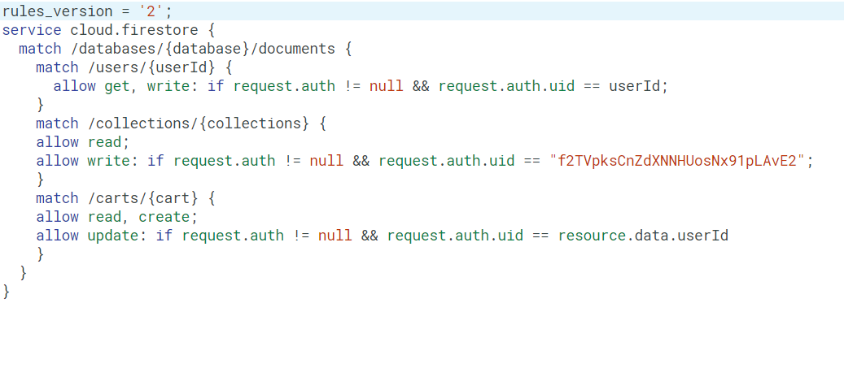
SNAPSHOTS/RULES
Snapshot to collection, to retrieve the store data
Database rules preventing anyone else from editing in the admin dashboard or client frontend

Slide 16
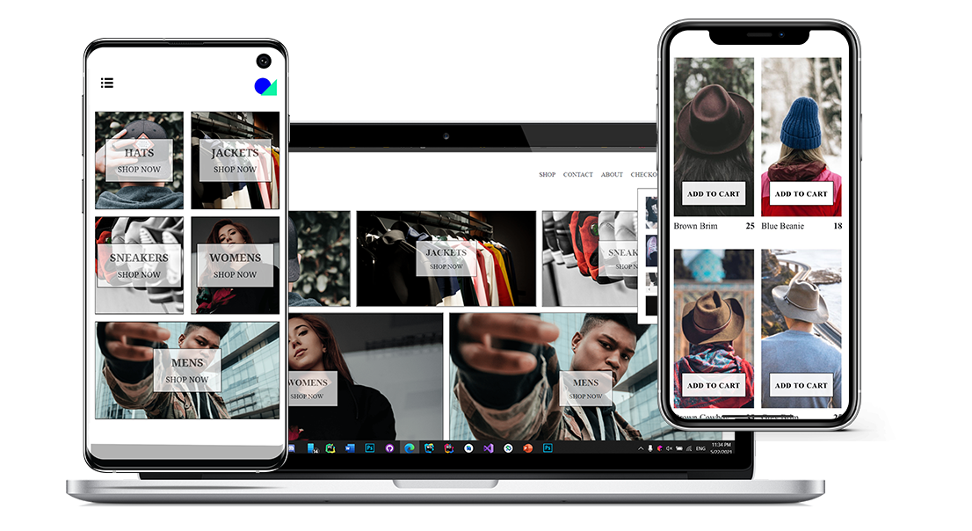
APPLICATION DEMO

Slide 17
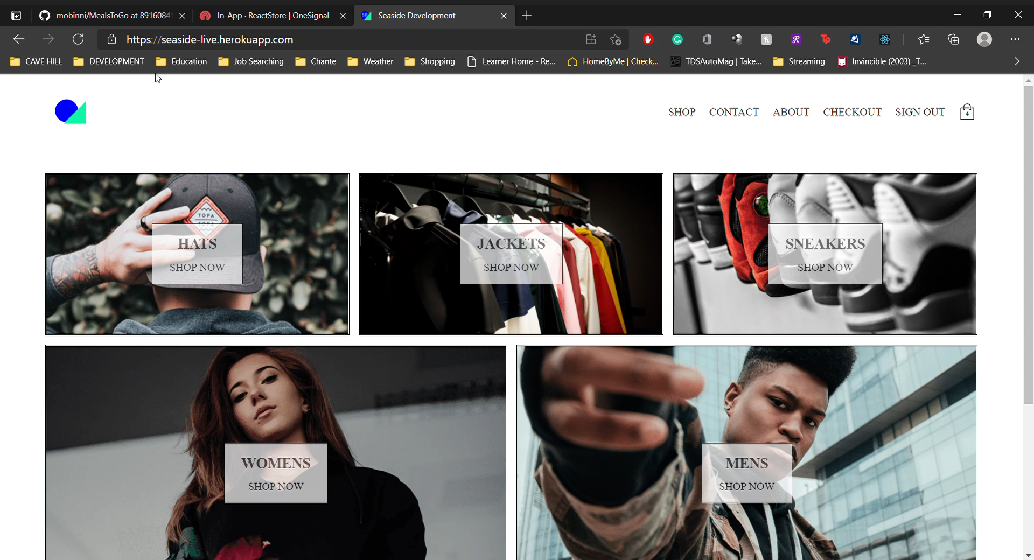
APP DEMO

Slide 18
BACKEND – NODE JS
By leverage Node Js. We can create a backend that removes security keys away from the client and allows us to integrate features the client wants.
We used Heroku to host the Backend Server and have Node Js listen and deploy the frontend
Reusable
Light Weight
Customizable to needs
Reduces App size (Compression included via Webpack)
Loads the Service Workers for Downloadable and Mobile Versions

Slide 19
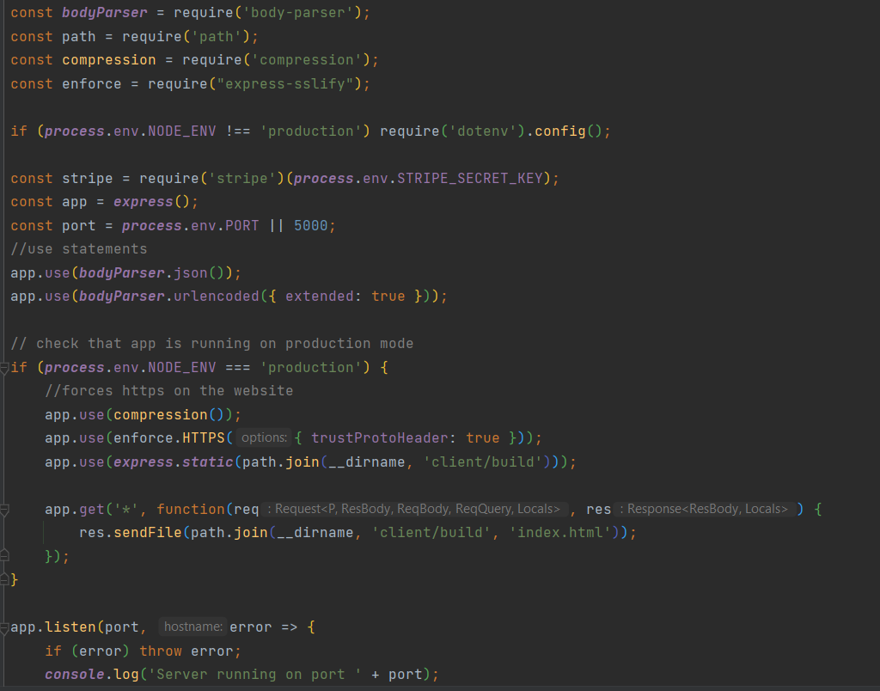
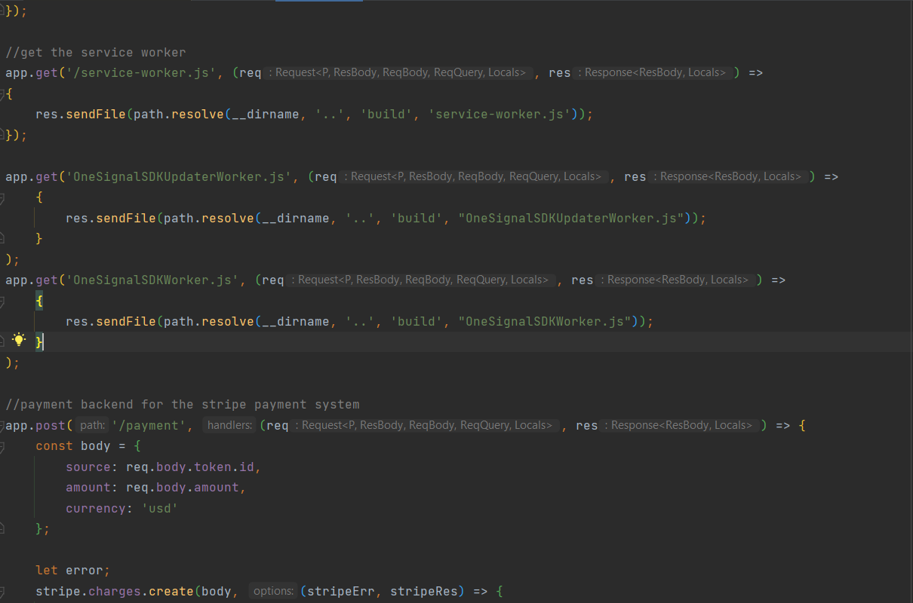

BACKEND CONT’D

Slide 20
PWA COMPLIENT
We Want To Reduce the Cost of Development to Clients
Cross platform
Downloadable
Session Storage
Reduced development cost
Emphasis on Feature sets
Check out our app report

Slide 21
WHAT NEXT?
We Want To Improve The Client And Their End User’s Experiences
Consolidate All APIs Under One URL
Use more containers
Distribute The App Better Using The Google Cloud.
Use Of Better Security Metrics, Like Biometrics.
Further Cross Platform Capabilities
Continue To Improve Customer And End User Satisfaction.
Improve caching states

Slide 22
Questions?

